Slide 1
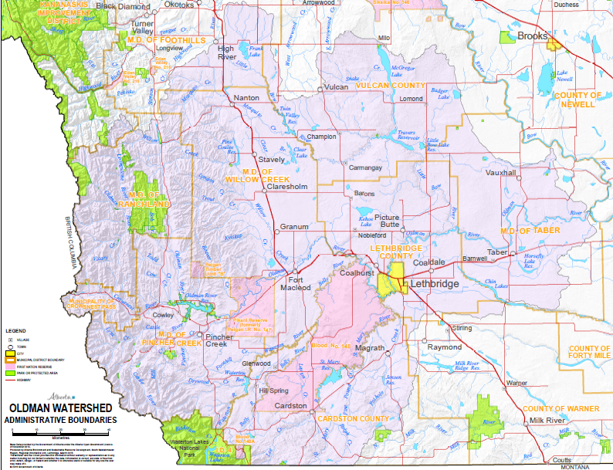
High
River
Vulcan
Nanton
Lomond
Direction of Laurentide Glacial Advance
A: 500 mg/L
Champion
Stavely
Carmangay
Vauxhall
Claresholm
B: 250 mg/L
Barons
Picture
Granum
Butte
Nobleford
Nobleford
Taber
Coaldale
Fort
Lethbridge
Macleod
C: 160 mg/L
Cowley
Oldman Watershed in Alberta
Directions of Cordilleran Glacial Advance
Pincher
Creek
D: 20 mg/L
Magrath
Glenwood
Hill Spring
Cardston

